Slide 1
ESG Diagnostics
Product deck

Slide 2
Bain uses three different products to assess ESG in diligences, ranging from a simple diagnostic to an ESD ODA and an ESG due diligence
1 | ESG diagnostics
2 | ESG ODA Assessment
3 | ESG due diligence
Standardized ESG scan to obtain an initial view on key ESG issues in target’s sector, level of materiality & value creation levers
Full ESG assessment including quantification of value drivers, resource requirements & monetization potential on ESG topics, fully integrated with other DD streams
Industry ESG Profile
Industry ESG maturity level & key material ESG topics to focus on basis customer, regulatory, investor etc. PoV
ESG “materiality assessment”
Initial view on potential ESG DD questions
Peer Benchmarking
Detailed qualitative ESG value creation opportunities for target
Quantitative and qualitative Target’s positioning compared to peers and best-in-class
Detail on benchmarking of competitors and/ or product types on each material ESG topic
Value Creation
Key growth and differentiation opportunities for the Target; quantified value creation potential and investments needed
Provides quick initial view on Target industry’s key material ESG issues and levels of materiality
Highlights scope for key DD questions on ESG assessment
Assessment of the point of departure, risk mitigation and qualitative ESG value creation opportunities through benchmarking and industry analysis
Include full quantification and deep-dives on value creation initiatives and implementation roadmap
Use case: Proposals / ODAs, Fund portfolio reviews Timeline: 1 day effort
Use case: Deals with low/medium ESG importance
Timeline: 1.5 - 2 days
Use case: Deals where ESG plays a major role Timeline: 1-3 weeks

Slide 3

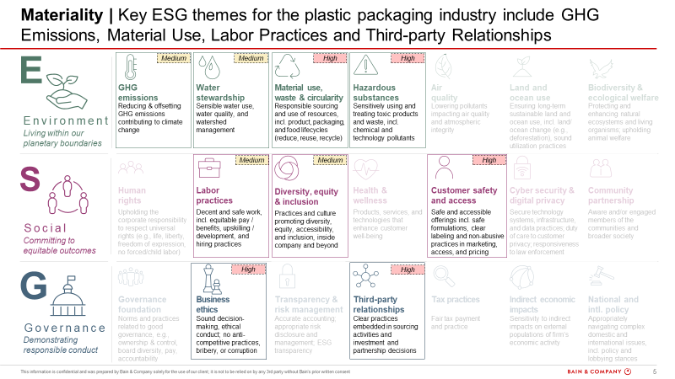
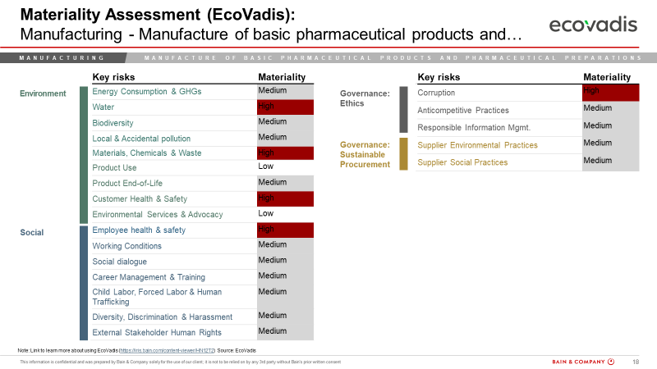
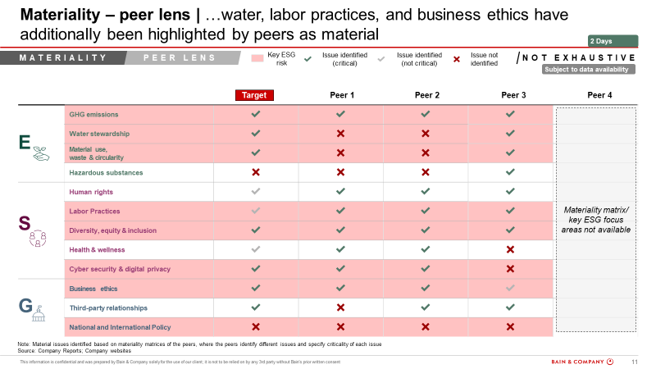

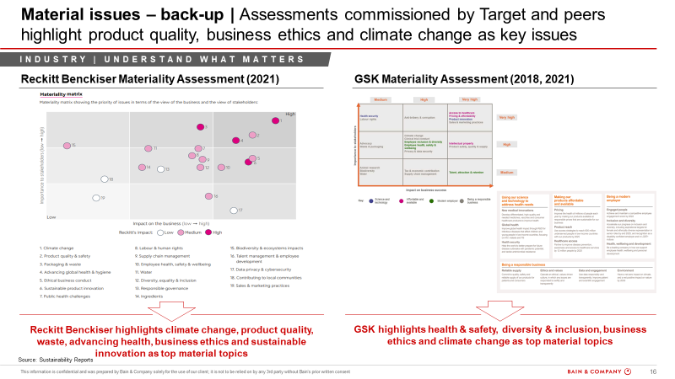
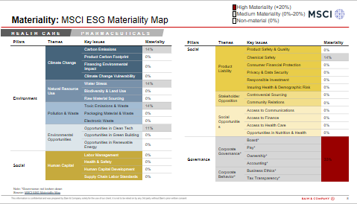
BCN PEG compliments the ESG Rave on materiality by adding an additional peer lens and providing a summary answer on materiality in the Bain ESG framework
ESG
Materiality
While the Rave offers material issues from Ecovadis and MSCI
BCN PEG includes additional peer lens in identifying material issues
To provide a collated view of ESG issues for the industry in focus
The additional peer lens helps specifically for industries where a direct industry match is not available on Ecovadis/MSCI
Industry and sector level analysis:
Assess the target’s industry and sector on ESG risk overall vs other industries
Determine the weightage of each of the three components: Environment, Social, Governance for the relevant sector
Identify the most important / high risk metrics for the sector and call out any hot topics or red-flags

Slide 4
ESG DD scope and proposal questions outline
ESG
DD Questions
Materiality assessment What are the most material ESG dimensions in the [target] industry?
What are the most material ESG dimensions and megatrends in the target’s industry?
What are the key ESG risks and impact on the target?
What is the perspective of key external stakeholders (incl. customers/ consumers, regulators and competitors as well as other relevant stakeholders)?
What are the most relevant regulations influencing the importance of these ESG topics for the industry?
Benchmarking How does Target Co perform on the most material E, S, and G metrics for the [target] industry?
What is the relevant set of quantitative KPIs to consider in this sector (e.g., scope 1-3 emissions, employee satisfaction, DE&I)?
What are the best-in-class examples of ESG maturity in the industry?
How do the target and peers perform on material topics? What are the risks / red-flags? Where is the target leading?
Which peers are reporting on ESG dimensions and what are their future targets and initiatives to achieve them?
Value creation What are the ESG value creation opportunities emerging for Target Co?
What is the target’s ESG ambition?
What is the value creation plan and overall impact potential in the business model?
What are the key initiatives and levers for value creation and risk reduction?

Slide 5
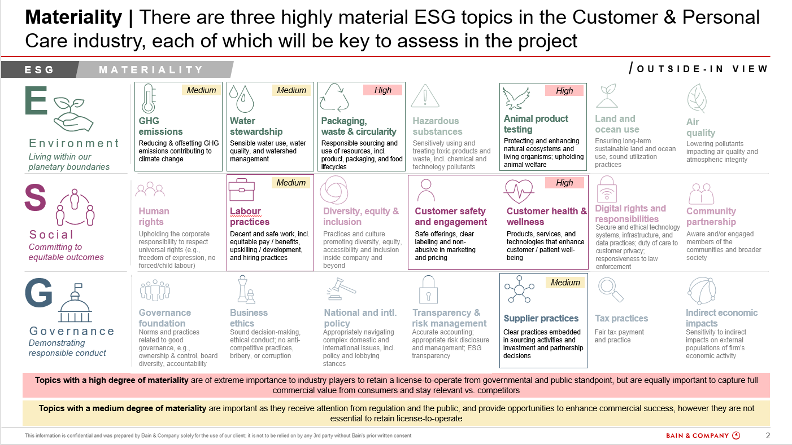
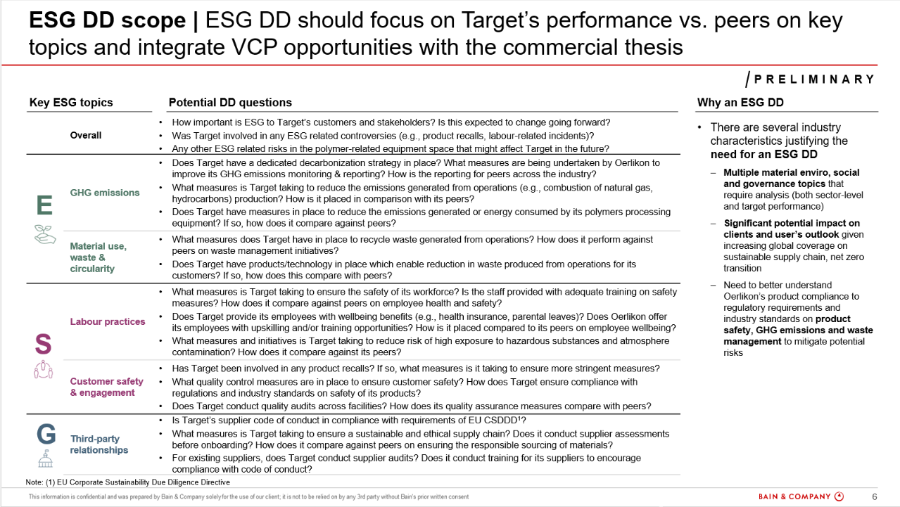
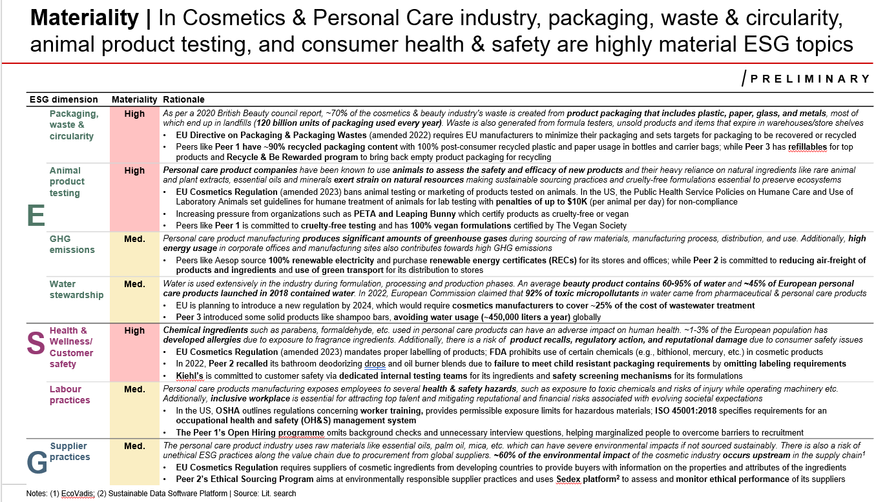
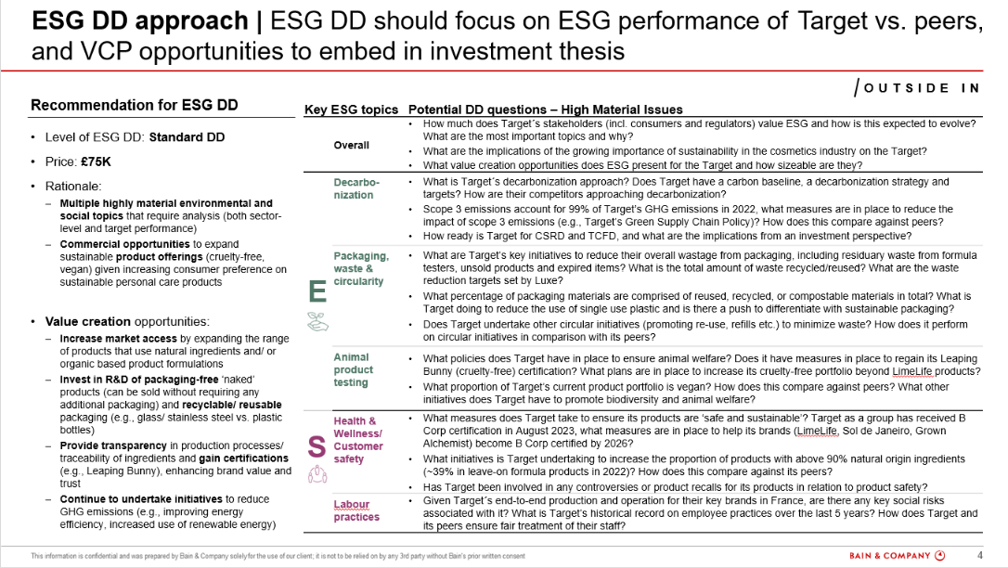
ESG Diagnostics Sample Output
ESG Materiality
Potential DD questions
Understand key material ESG risks in the Target’s industry and their level of materiality from regulatory and peer lens
Key potential ESG DD questions to assess and benchmark Target’s ESG performance
Note: Persefoni cost would be additional

